Slide 1


Shaghayegh Haghbin
21/02/2024

Slide 2

Outline
Executive Summary
Introduction
Methodology
Results
Conclusion
Appendix

Slide 3
Executive Summary
Summary of methodologies:
Week 1: Data Collection API, Data Collection with Web Scraping, Data Wrangling.
Week 2: Exploratory Data Analysis with SQL, Exploratory Data Analysis with Visualization.
Week 3: Interactive Visual Analytics with Folium, Building an Interactive Dashboard with Ploty Dash.
Week 4: Machine Learning Prediction.
Week 5: final report for peer review
Summary of all results:
Obtained critical insights from publicly accessible sources.
Exploratory Data Analysis enabled the identification of the key factors for predicting launching success.
Machine Learning Prediction demonstrated an effective model for predicting essential factors, utilizing all gathered data.

Slide 4
Introduction
Project background and context:
Utilizing predictive analysis, this project focuses on predicting if the beginning phase of Falcon 9 will have a successful landing or not.
SpaceX promotes Falcon 9 rocket launch services on its official website, priced at 62 million dollars. In contrast, other providers typically command prices exceeding 165 million dollars per launch. A significant factor contributing to these cost disparities is SpaceX's innovative capability to reuse the first stage of the rocket.
Problems you want to find answers:
Factors influencing successful rocket landings.
Interaction of key features impacting landing success.
Operating conditions essential for a successful landing program.

Slide 5

Section 1

Slide 6
Methodology
Executive Summary
Data collection methodology:
The source for SpaceX API is https://api.spacexdata.com/v4/rockets/
The source for web scraping is https://en.wikipedia.org/wiki/List_of_Falcon/_9/_and_Falcon_Heavy_launches
Perform data wrangling:
Enhanced data collection by developing a landing outcome label through comprehensive analysis and key features summarization.
Perform exploratory data analysis (EDA) using visualization and SQL.

Slide 7
Methodology
Executive Summary
Perform interactive visual analytics using Folium and Plotly Dash.
Perform predictive analysis using classification models:
The gathered data underwent normalization and was partitioned into training and test datasets.
In the evaluation phase, there was an employment of four distinct classification models.
Model accuracy was assessed across various parameter combinations.

Slide 8
Data Collection
Describe how data sets were collected.
The source for SpaceX API dataset collection is: https://api.spacexdata.com/v4/rockets/
The source for web scraping is: https://en.wikipedia.org/wiki/List_of_Falcon/_9/_and_Falcon_Heavy_launches

Slide 9
Data Collection – SpaceX API
Data acquisition was facilitated utilizing SpaceX's public API, following the outlined flowchart, and persisted for further analysis.
GitHub URL: https://github.com/Sherrymdx1377/Applied-Data-Science-Capstone/blob/main/week%201/Data%20Collection%20API%20Lab.ipynb
Initiate API requests to retrieve and parse SpaceX launch data.
Implement filtering mechanisms to isolate Falcon 9 launches exclusively.
Address any missing values within the dataset.

Slide 10
Data Collection - Scraping
Data sourced from SpaceX launches, including accessible information via Wikipedia are acquired following the outlined flowchart and persisted for analysis.
GitHub URL: https://github.com/Sherrymdx1377/Applied-Data-Science-Capstone/blob/main/week%201/Data%20Collection%20with%20Web%20Scraping%20lab.ipynb
Retrieve the Wikipedia page for Falcon 9 Launch.
From the HTML table header, retrieve every column and variable names.
Parsing the HTML tables associated with the launch data generates a data frame.

Slide 11
Data Wrangling
The dataset underwent initial Exploratory Data Analysis. Following that, analyses were conducted to determine the number of launches per site, instances of each orbit and results categorized by orbit type. Lastly, the landing outcome label was generated based on the data within the Outcome column.
GitHub URL: https://github.com/Sherrymdx1377/Applied-Data-Science-Capstone/blob/main/week%201/Data%20wrangling.ipynb
Exploratory Data Analysis
Overview
Generation of Landing Outcome label

Slide 12
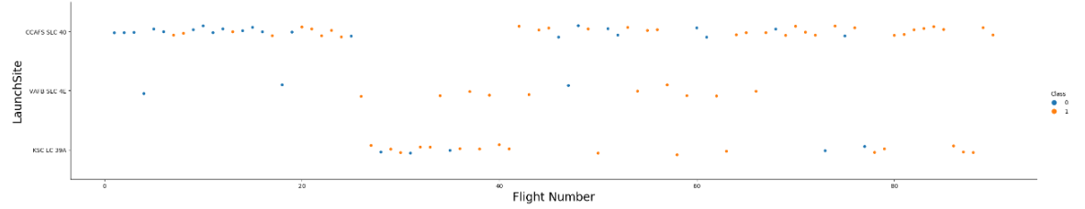
EDA with Data Visualization
During the Exploratory Data Analysis with Data Visualization phase, plots like scatterplots and bar plots were employed to investigate data and illustrate the correlation between the sets of variables:
Payload Mass X Flight Number
Launch Site X Flight Number
Launch Site X Payload Mass
Orbit and Flight Number
Payload and Orbit
GitHub URL: https://github.com/Sherrymdx1377/Applied-Data-Science-Capstone/blob/main/week%202/EDA%20with%20Visualization.ipynb

Slide 13
EDA with SQL
Task 1: Display the names of the unique launch sites in the space mission
Task 2: Display 5 records where launch sites begin with the string 'CCA’
Task 3: Display the total payload mass carried by boosters launched by NASA (CRS)
Task 4: Display average payload mass carried by booster version F9 v1.1
Task 5: List the date when the first successful landing outcome in ground pad was achieved.
Task 6: List the names of the boosters which have success in drone ship and have payload mass greater than 4000 but less than 6000
Task 7: List the total number of successful and failure mission outcomes
Task 8: List the names of the booster_versions which have carried the maximum payload mass.

Slide 14
EDA with SQL
Task 9: List the records which will display the month names, failure landing_outcomes in drone ship ,booster versions, launch_site for the months in year 2015.
Task 10: Rank the count of landing outcomes (such as Failure (drone ship) or Success (ground pad)) between the date 2010-06-04 and 2017-03-20, in descending order.
GitHub URL: https://github.com/Sherrymdx1377/Applied-Data-Science-Capstone/blob/main/week%202/EDA%20with%20SQL.ipynb

Slide 15
Build an Interactive Map with Folium
Folium Maps employed markers, circles, lines, and marker clusters in its design and implementation.
Markers denote locations such as launch sites.
Circles designate highlighted zones surrounding coordinates, such as the NASA Johnson Space Center.
Marker clusters signify collections of occurrences at each coordinate, like launches in a launch site.
Lines are employed to illustrate the distance between two sets of coordinates.
GitHub URL: https://github.com/Sherrymdx1377/Applied-Data-Science-Capstone/blob/main/week%203/Launch%20Sites%20Locations%20Analysis%20with%20Folium.ipynb

Slide 16
Build a Dashboard with Plotly Dash
Graphs and plots were utilized to visually represent data, including the percentage of launches categorized by site and payload range.
This integration enabled a rapid examination of the correlation between payloads and launch sites, assisting in determining the most suitable launch locations based on payload requirements.
GitHub URL: https://github.com/Sherrymdx1377/Applied-Data-Science-Capstone/blob/main/week%203/spacex_dash_app.py

Slide 17
Predictive Analysis (Classification)
Standardize and pre-process the data
During the Machine Learning Prediction phase, four types of classification models were evaluated:
Logistic Regression
Support Vector Machine
Decision Tree
K-Nearest Neighbors
GitHub URL: https://github.com/Sherrymdx1377/Applied-Data-Science-Capstone/blob/main/week%204/Machine%20Learning%20Prediction.ipynb
Evaluating each model with various hyperparameter configurations
Analyzing the outcomes

Slide 18
Results
Exploratory data analysis results:
SpaceX operates from four distinct launch sites, initially conducting launches both for SpaceX itself and in collaboration with NASA. The average payload for the F9 v1.1 booster stands at 2,928 kg. Notably, the first successful landing occurred in 2015, five years following the inaugural launch. Over time, several Falcon 9 booster iterations achieved successful landings on drone ships, particularly with payloads exceeding the average. Mission success rates approached nearly 100%. However, in 2015, two booster versions, F9 v1.1 B1012 and F9 v1.1 B1015, encountered failed landing attempts on drone ships. Nevertheless, the frequency of successful landings progressively improved with each passing year.

Slide 19
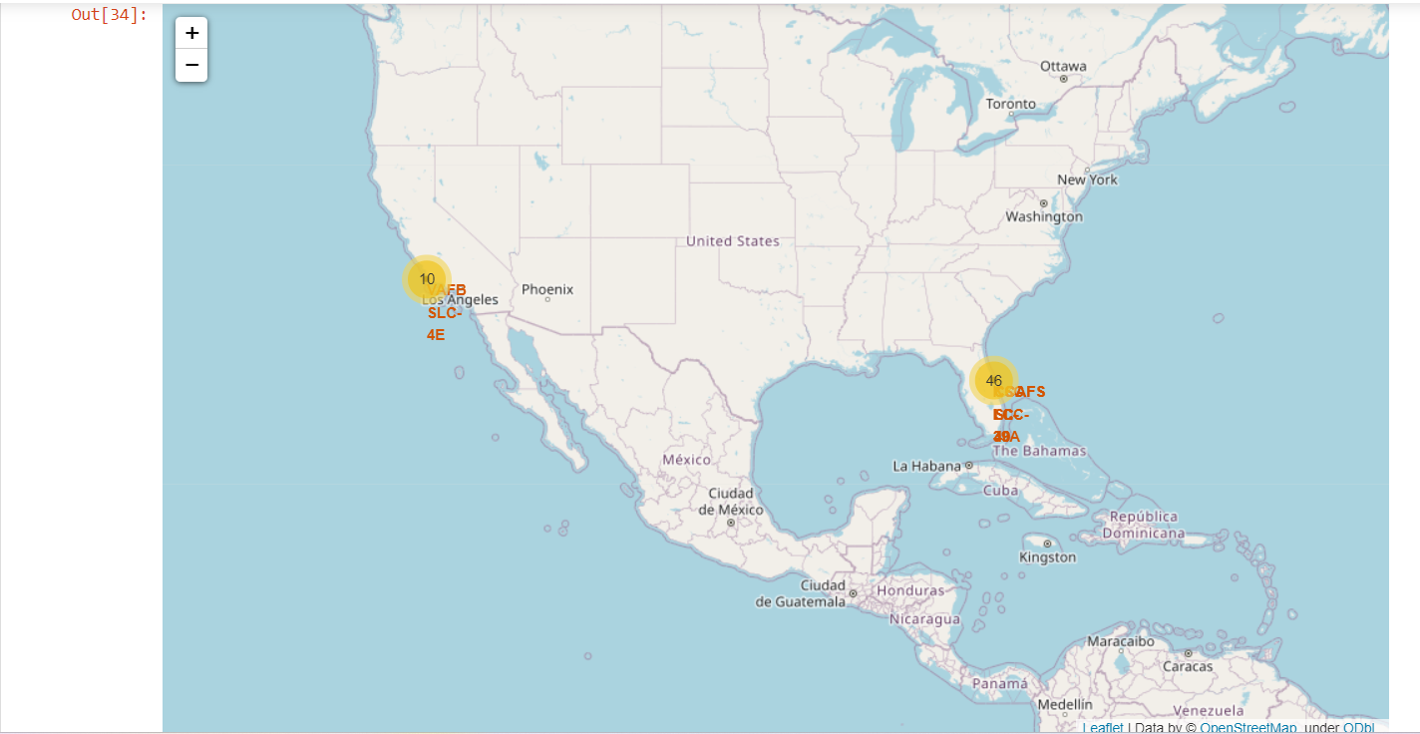
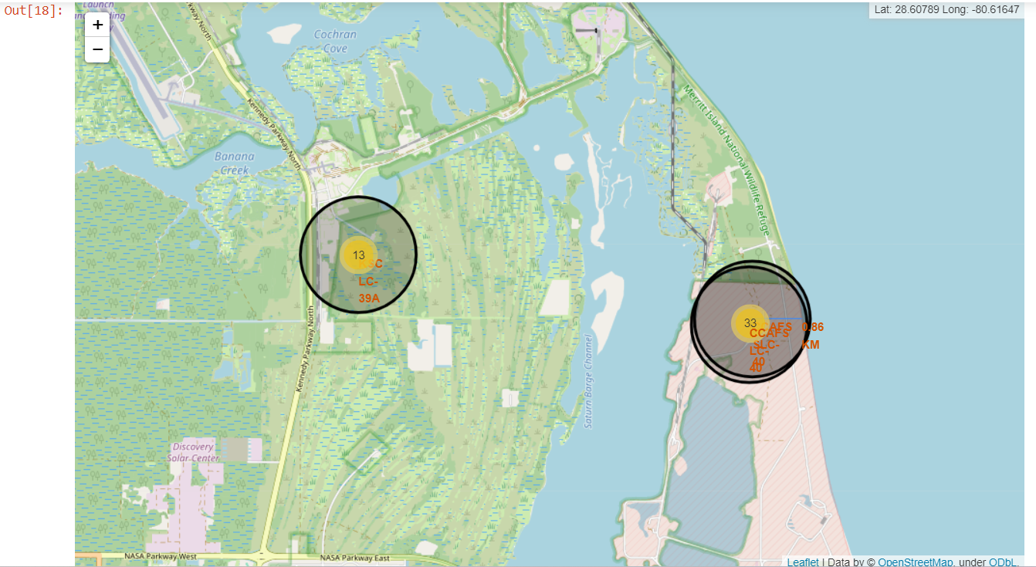
Results
Leveraging interactive analytics revealed that launch sites tend to be situated in secure locations, often near bodies of water such as the sea, and are surrounded by well-developed logistical infrastructure. Furthermore, maximum launches occur at launch sites situated along the east coast.

Slide 20
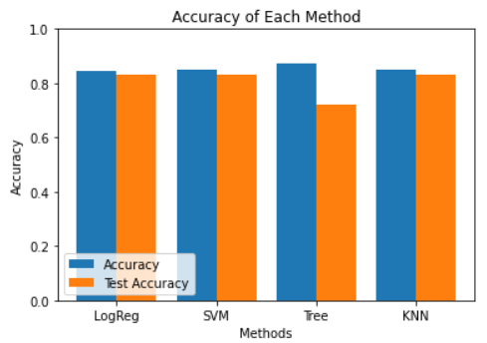
Results
Predictive analysis indicated that the Decision Tree Classifier emerges as the optimal model for forecasting successful landings.
This model boasts an accuracy exceeding 87% and achieves a test data accuracy surpassing 94%.

Slide 21

Section 2

Slide 22
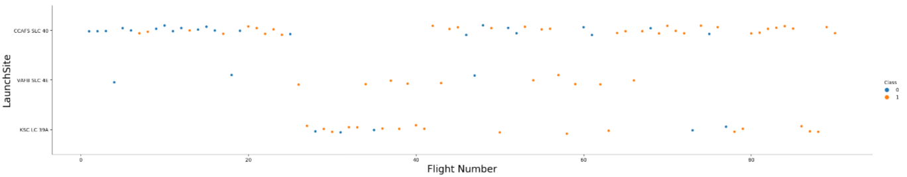
Flight Number vs. Launch Site
Based on the depicted plot, it is evident that the premier launch site currently is CCAF5 SLC 40, showcasing a predominant success rate in recent launches. Following closely is VAFB SLC 4E, occupying the second position, and KSC LC 39A in third place. Moreover, a notable observation from the plot reveals a progressive enhancement in the overall success rate over time.

Slide 23
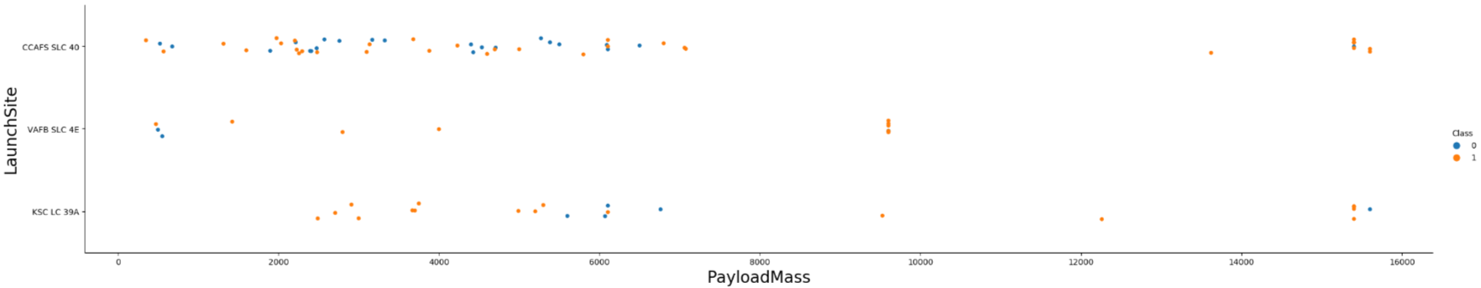
Payload vs. Launch Site
Payloads exceeding 9,000kg exhibit a notably high success rate, suggesting their robust performance. Furthermore, payloads surpassing 12,000kg appear feasible solely at the CCAFS SLC 40 and KSC LC 39A launch sites, implying their capability to accommodate heavier payloads effectively.

Slide 24
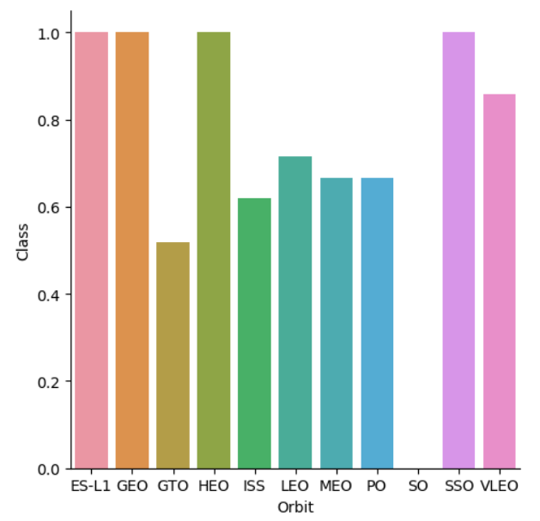
Success Rate vs. Orbit Type
The highest success rates are observed in specific orbits, including ES-L1, GEO, HEO, and SSO.
These orbits exhibit the most consistent success rates.
Following closely are VLEO, with a success rate exceeding 80%, and LFO, boasting a success rate surpassing 70%.

Slide 25
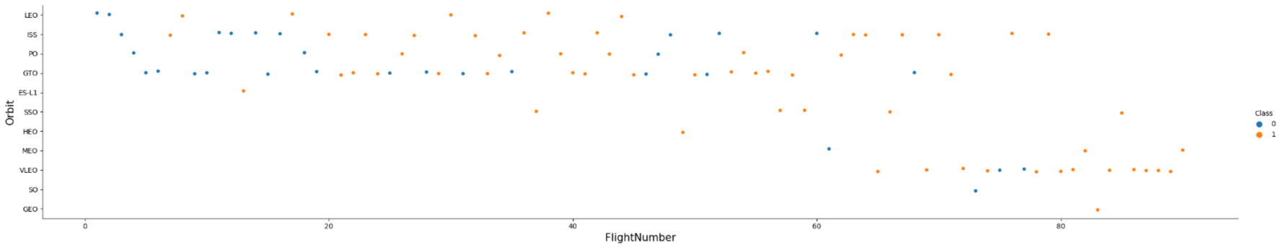
Flight Number vs. Orbit Type
The success rate has progressively enhanced over time across all orbits, indicating an overall improvement in launch reliability. Notably is the emergence of VLEO orbit as a promising business opportunity, evident from its recent surge in launch frequency. This trend underscores the growing significance and potential profitability associated with VLEO missions in the contemporary space industry landscape.

Slide 26
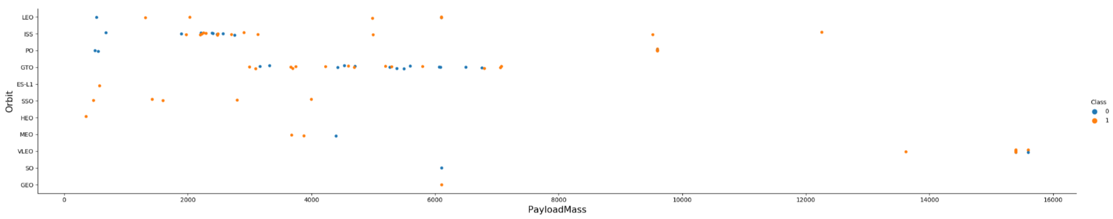
Payload vs. Orbit Type
There is no discernible correlation between payload size and success rate for launches to the GTO orbit. On the other hand, the ISS orbit exhibits the broadest range of payload capacities while maintaining a commendable success rate. Additionally, there are relatively few launches to the SO and GEO orbits, indicating these orbits are less frequently utilized for space missions.

Slide 27
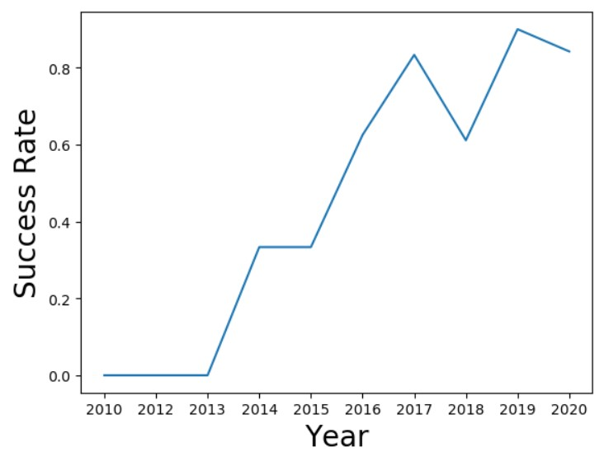
Launch Success Yearly Trend
The success rate began its upward trajectory in 2013 and continued to rise steadily until 2020, indicating a sustained period of improvement and refinement. The initial three years served as a crucial period for adjustments and technological advancements, laying the groundwork for the subsequent increase in success rates.

Slide 28
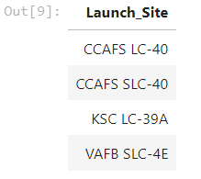
All Launch Site Names
The dataset reveals the existence of four distinct launch sites: CCAFS LC-40, CCAFS SLC-40, KSC LC-39A, and VAFB SLC-4E. These sites are identified by extracting the unique instances of "launch_site" values within the dataset, indicating the diverse locations from which launches are conducted.

Slide 29
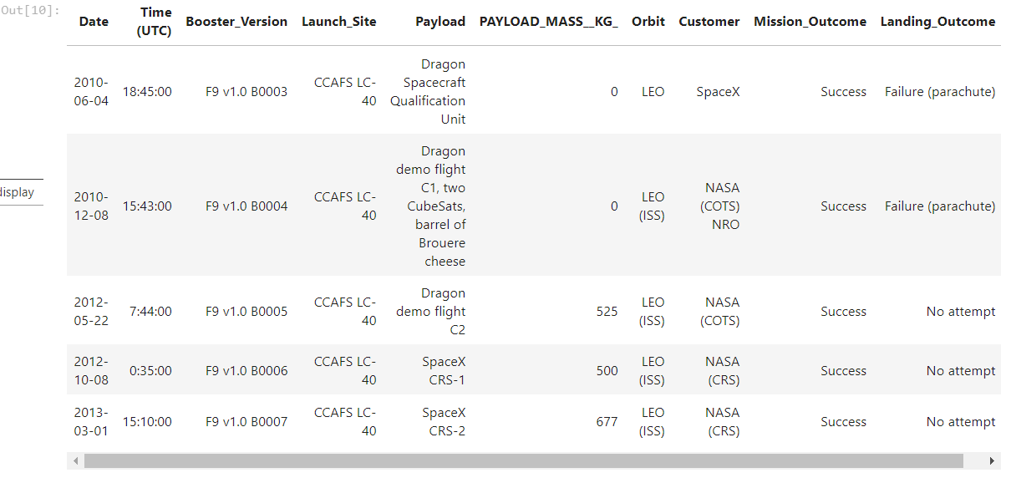
Launch Site Names Begin with 'CCA'
Here are 5 records where launch sites begin with 'CCA’:

Slide 30
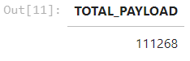
Total Payload Mass
Above is the total payload carried by boosters from NASA:
The total payload calculated previously is derived from the summation of all payloads identified with codes containing 'CRS', indicative of payloads associated with NASA missions.

Slide 31
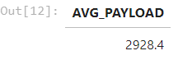
Average Payload Mass by F9 v1.1
Above displays Average payload mass carried by booster version F9 v1.1.
After filtering the data based on the specified booster version and computing the average payload mass, the value amounts to 2928.4 kg

Slide 32
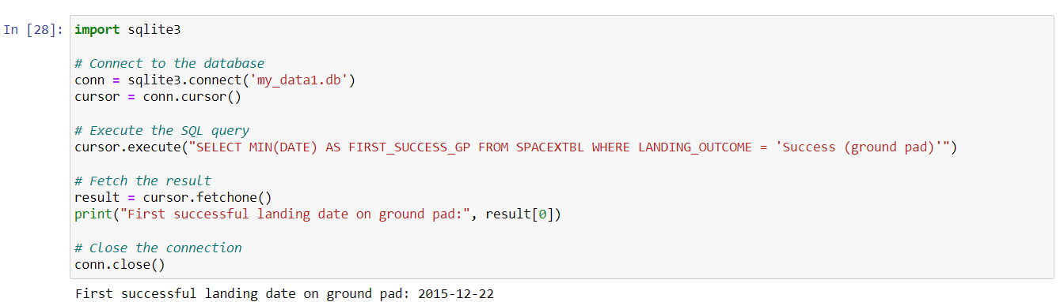
First Successful Ground Landing Date

Slide 33
First Successful Ground Landing Date
The first successful ground landing date is 2015-12-22
The ‘sqlite3’ library connects to an SQLite database named 'my_data1.db’.
It establishes a connection and creates a cursor object to execute SQL queries.
The code then executes an SQL query to find the earliest successful landing date on the ground pad from the 'SPACEXTBL' table, filtering by the 'LANDING_OUTCOME' column.
It fetches the result of the query, which contains the earliest successful landing date, and prints it out.
Finally, the code closes the connection to the database to release resources and maintain data integrity.

Slide 34
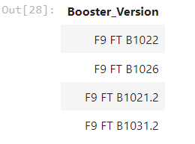
Successful Drone Ship Landing with Payload between 4000 and 6000
The following four boosters represent the result of selecting distinct booster versions that have successfully landed on a drone ship with a payload mass greater than 4000 but less than 6000.

Slide 35
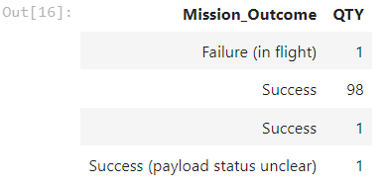
Total Number of Successful and Failure Mission Outcomes
Above represents several successful and failure mission outcomes. The summary above is derived from grouping mission outcomes and counting the records for each group.

Slide 36
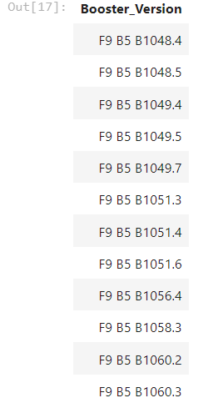
Boosters Carried Maximum Payload
Above are the boosters representing the maximum payload mass carried, as recorded in the dataset.

Slide 37
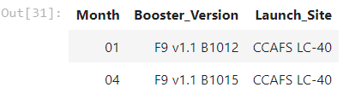
2015 Launch Records
The provided list contains the sole occurrences of failed landing outcomes on a drone ship, including details such as their booster versions and launch site names, all documented within the year 2015.

Slide 38
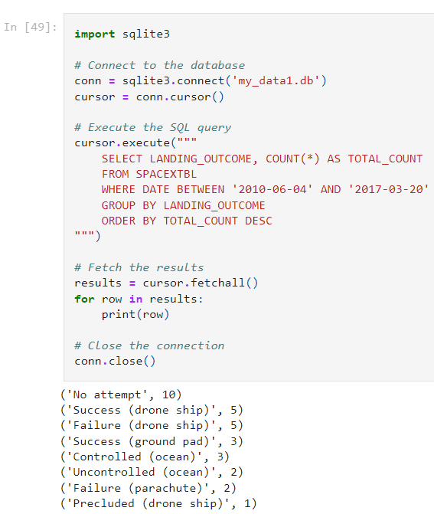
Rank Landing Outcomes Between 2010-06-04 and 2017-03-20
This code output showcases the ranking of all landing outcomes recorded between June 4th, 2010, and March 20th, 2017. It's crucial to note that the category of "No attempt" should also be considered in this analysis.

Slide 39

Section 3

Slide 40
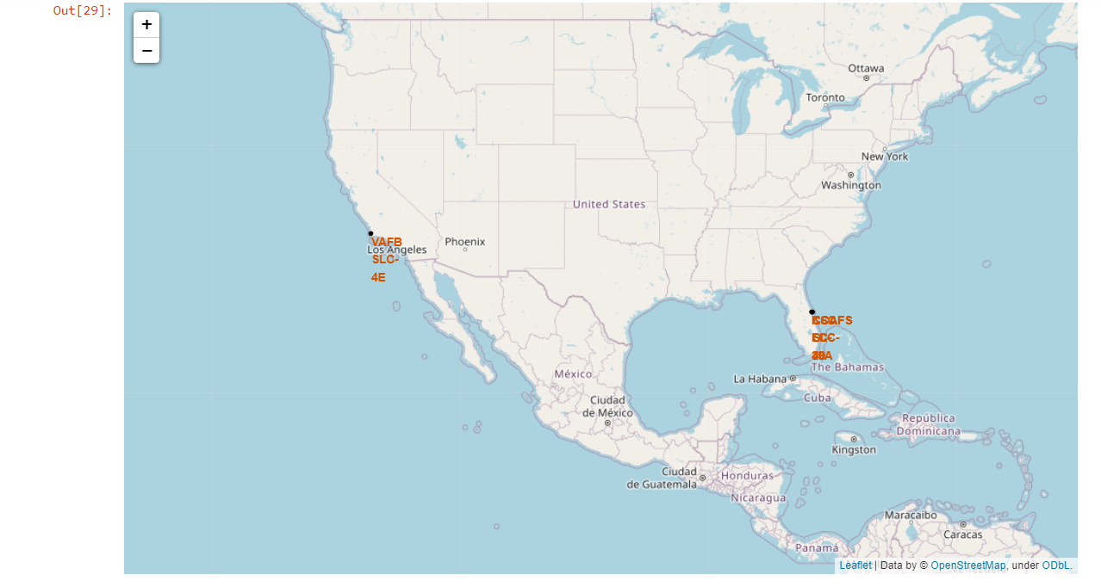
All launch sites
According to the map, Launch sites are typically situated near the sea, likely for safety considerations, while still being conveniently accessible from nearby roads and rail networks.

Slide 41
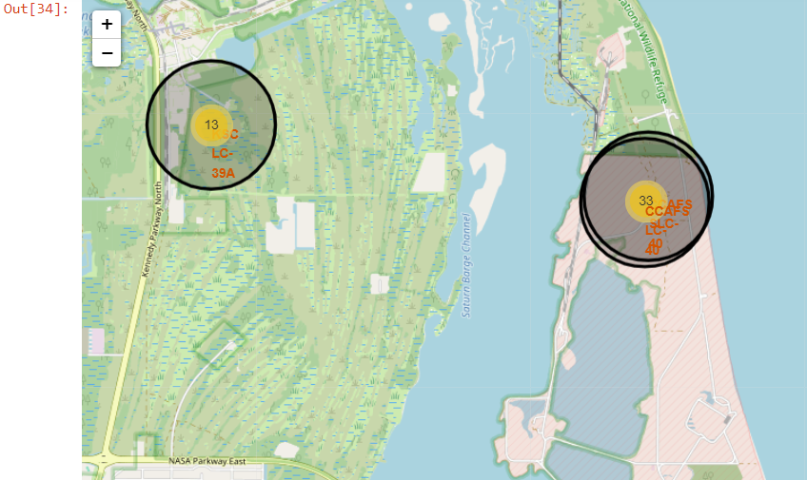
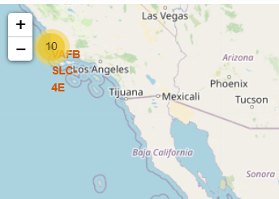
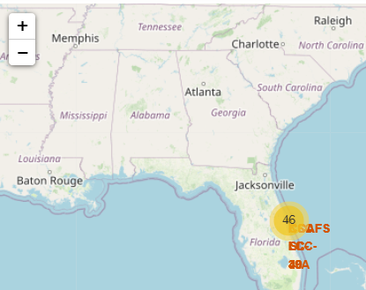
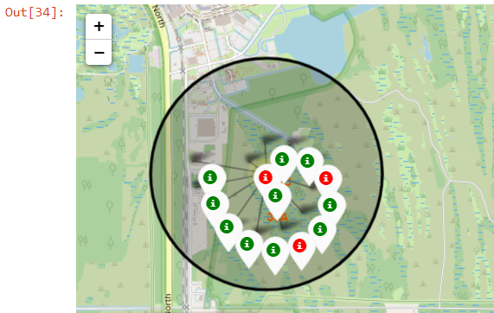
Site Launch Outcomes
Above is a map illustration showcasing the launch outcomes at KSC LC-39A features green markers denoting successful launches and red markers indicating instances of failure.

Slide 42
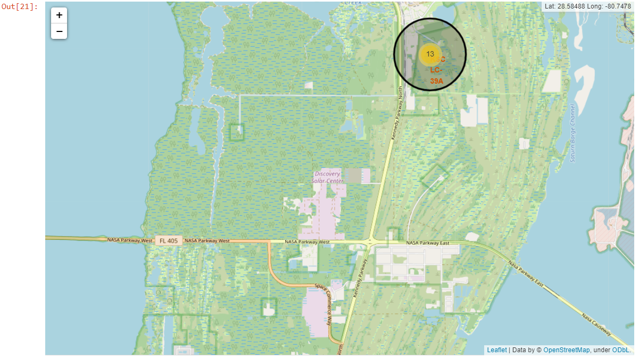
Launch site logistics and safety
The logistics setup at launch site KSC LC-39A is favorable, benefiting from its proximity to both railroad and road infrastructure, while also maintaining a relatively safe distance from populated areas.

Slide 43

Section 4

Slide 44
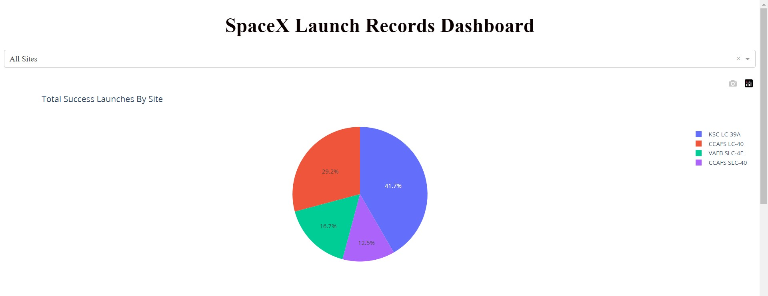
Total successful launches by site
The screenshot indicates that the launch location plays a crucial role in the success of missions.

Slide 45
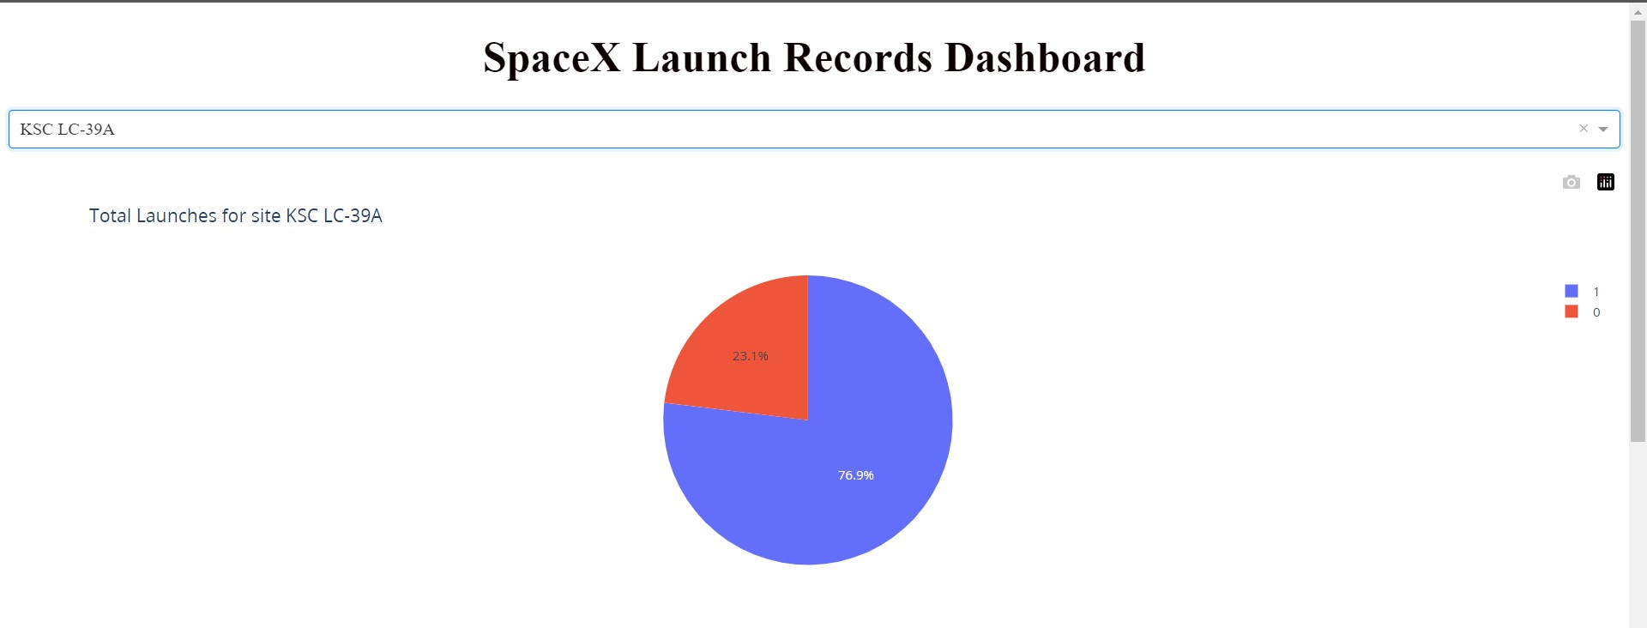
KSC LC-39A launch success rate
At this site, the success rate for launches stands at 76.9%.

Slide 46
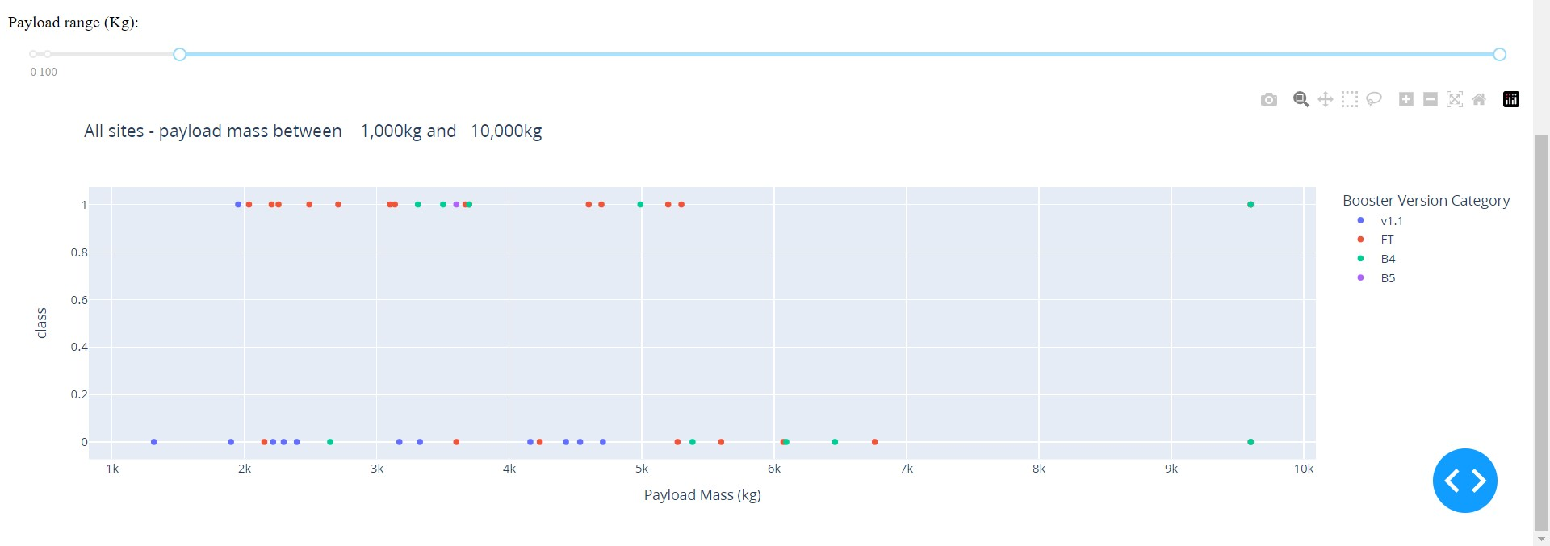
Payload and Launch Outcome Scatterplot Analysis
Based on the scatterplot, the combination of payloads weighing less than 6,000kg paired with FT boosters has demonstrated the highest success rate.

Slide 47
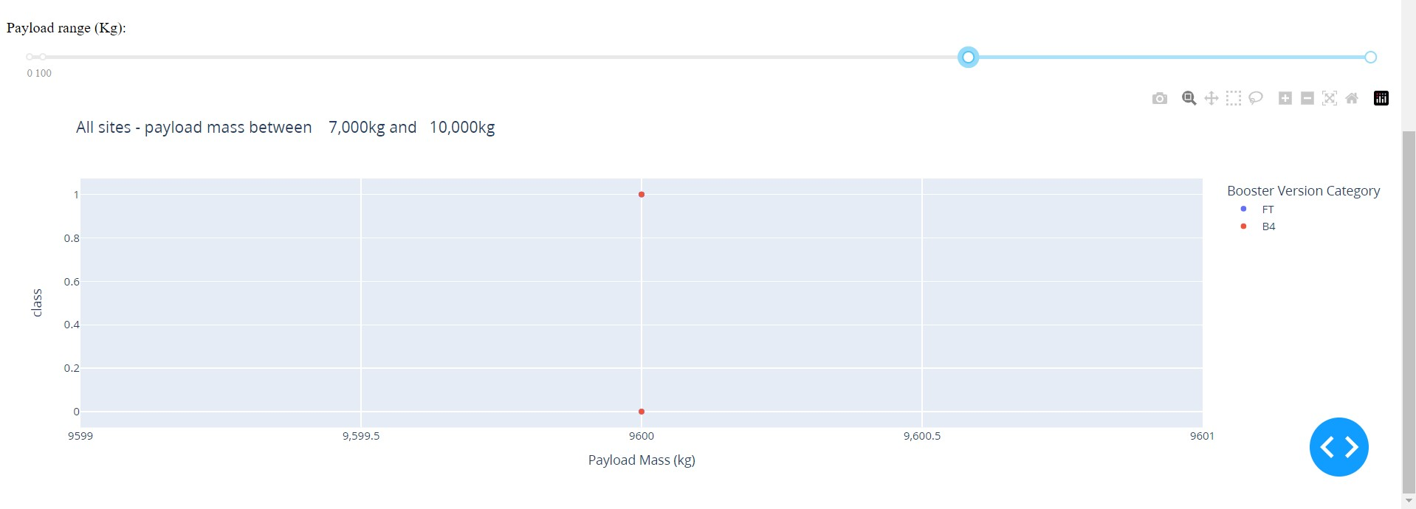
Payload and Launch Outcome Scatterplot Analysis
Based on the scatterplot, Insufficient data is available to accurately assess the risk associated with launches exceeding 7,000kg.

Slide 48

Section 5

Slide 49
Classification Accuracy
Four classification models underwent testing, and their respective accuracies are depicted in the accompanying plot. Among these models, the Decision Tree Classifier emerged with the highest classification accuracy, surpassing 87%.

Slide 50
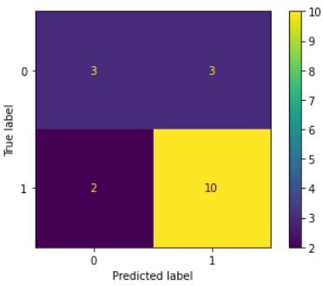
Decision Tree Confusion Matrix
True Positives for did not land class: 3 instances correctly predicted as did not land.
False Negatives for landed class: 3 instances incorrectly predicted as did not land when they landed.
False Positives for did not land class: 2 instances incorrectly predicted as did not land when they landed.
True Positives for landed class: 12 instances correctly predicted as landed.
The effectiveness of the Decision Tree Classifier is demonstrated through its confusion matrix, highlighting substantial counts of true positives and true negatives relative to the occurrences of false positives and false negatives.

Slide 51
Conclusions
The analysis involved the examination of various data sources, leading to refined conclusions.
After thorough evaluation, KSC LC-39A emerged as the optimal launch site.
Launches involving payloads exceeding 7,000kg tend to pose lower risks.
While overall mission success rates are promising, successful landings show improvement over time, reflecting advancements in processes and rocket technology.
Utilizing the Decision Tree Classifier can effectively forecast successful landings, thereby enhancing profitability.

Slide 52
Appendix
Full Project GitHub URL: https://github.com/Sherrymdx1377/Applied-Data-Science-Capstone
Launch Sites Locations Analysis with Folium screenshots (since the images did not load on GitHub): https://github.com/Sherrymdx1377/Applied-Data-Science-Capstone/tree/main/week%203/Interactive%20Visual%20Analytics%20with%20Folium%20lab

Slide 53


